Slide 1
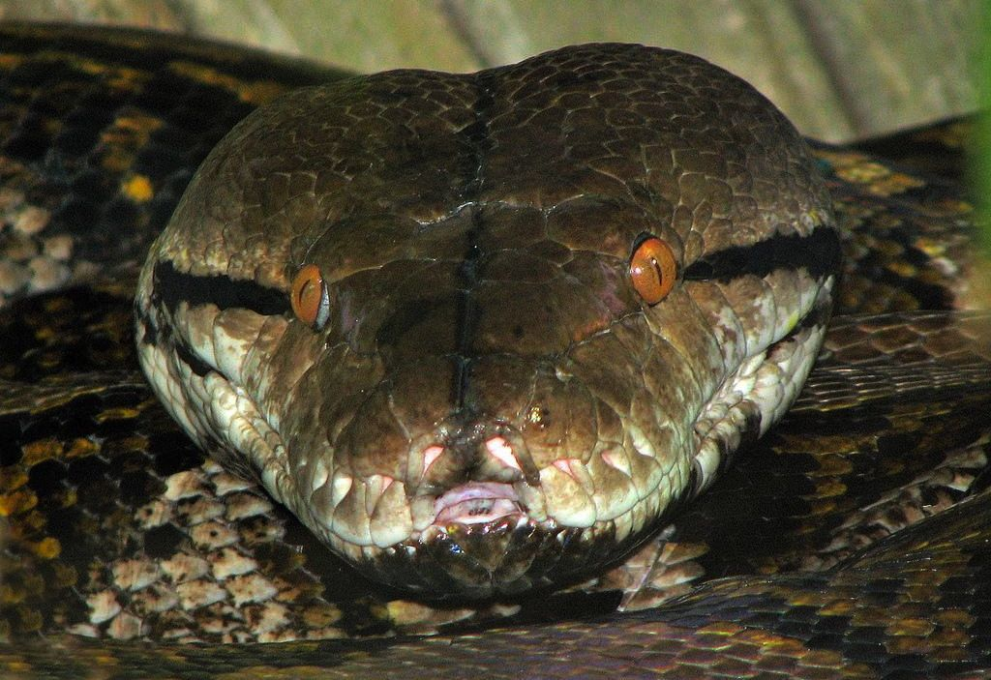
CHAPTER 14 DICTIONARIES

Slide 2
Unit 2:
XI
Computer Science (083)
Board : CBSE
Computational Thinking and Programming
Courtesy CBSE

Slide 3
LEARNING OUTCOMES

Slide 4
LEARNING OUTCOMES
After studying this lesson, students will be able to:
Understand the need of dictionaries;
Solve problems by using dictionaries;
Get clear idea about dictionaries functions; and
Understand the difference between list and dictionary.

Slide 5
WHAT IS DICTIONARY?

Slide 6
WHAT IS DICTIONARY?
A dictionary is like a list, but more in general. In a list, index value is an integer, while in a dictionary index value can be any other data type and are called keys. The key will be used as a string as it is easy to recall. A dictionary is an extremely useful data storage construct for storing and retrieving all key value pairs, where each element is accessed (or indexed) by a unique key. However, dictionary keys are not in sequences and hence maintain no left-to right order.

Slide 7
KEY VALYE PAIR
We can refer to a dictionary as a mapping between a set of indices (which are called keys) and a set of values. Each key maps a value. The association of a key and a value is called a key-value pair.
Syntax:
my_dict = {'key1': 'value1','key2': 'value2','key3': 'value3'…'keyn': 'valuen'}

Slide 8
DICTIONARIES
Curley brackets are used to represent a dictionary.
Each pair in the dictionary is represented by a key and value separated by a colon.
Multiple pairs are separated by vcomas

Slide 9
DICTIONARIES
A dictionary is an un­ordered collection of key­value pairs.
A dictionary has a length, specifically the number of key­value pairs.
A dictionary provides fast look up by key.
The keys must be immutable object types.

Slide 10
STATE DIAGRAM
>>> A={1:"one",2:"two",3:"three"}
1 one
2 two
3 three
A =
KEYS
VALUES

Slide 11
CREATING A DICTIONARY – dict()

Slide 12
CREATING DICTIONARAY – dict()
The function dict ( ) is used to create a new dictionary with no items. This function is called built-in function. We can also create dictionary using {}.

Slide 13
CREATING DICTIONARAY – Example

Slide 14
CREATING AND TRAVERSING DICTIONARAY

Slide 15
CREATING AND TRAVERSING DICTIONARAY
OUT PUT

Slide 16
CREATING AND TRAVERSING DICTIONARAY
OUT PUT

Slide 17
DICTIONARAY – BUILT IN METHODS

Slide 18
DICTIONARAY – BUILT IN METHODS
Dictionary Method | Meaning
dict.clear() | Removes all the elements of the dictionary
dict.copy() | Returns (shallow)copy of dictionary.
dict.get(key, default=None) | for key key, returns value or default if key not in dictionary (note that default's default is None)
dict.items() | returns a list of dict's (key, value) tuple pairs

Slide 19
DICTIONARAY – BUILT IN METHODS
Dictionary Method | Meaning
dict.keys() | returns list of dictionary dict's keys
dict.setdefault key, default=None | similar to get(), but will set dict[key]=default if key is not already in dict
dict.update(dict2) | adds dictionary dict2's key-values pairs to dict
dict.values() | returns list of dictionary dict's values

Slide 20
DICTIONARAY – BUILT IN METHODS
Dictionary Method | Meaning
dict.pop() | returns list of dictionary dict's keys
dict.popitem() | similar to get(), but will set dict[key]=default if key is not already in dict

Slide 21
dict.clear() METHOD
clear method
OUTPUT is in next slide!

Slide 22
dict.clear() METHOD - OUTPUT
Birthday dictionary cleared

Slide 23
dict.copy() METHOD
copy method
OUTPUT is in next slide!

Slide 24
dict.copy() METHOD - OUTPUT
copy method creates b2 dictionary

Slide 25
dict.get() METHOD
get method
OUTPUT is in next slide!

Slide 26
dict.get() METHOD - OUTPUT
Creating a b2 dictionary using get method

Slide 27
dict.items() METHOD
items method
OUTPUT is in next slide!

Slide 28
dict.items() METHOD - OUTPUT
items method returns dictionary content

Slide 29
dict.keys() METHOD
keys method
OUTPUT is in next slide!

Slide 30
dict.keys() METHOD - OUTPUT
keys method returns dictionary keys

Slide 31
dict.update() METHOD
update method

Slide 32
dict.values() METHOD
values method returns dictionary values

Slide 33
dict.pop() METHOD
pop method removes specified key values from the dictionary

Slide 34
dict.popitem() METHOD
popitem method removes values/items from the dictionary

Slide 35
CLASS WORK/HOME WORK

Slide 36
CLASS WORK/HOME WORK
1. Write a Python script to sort (ascending and descending) a dictionary by value.
2. Write a Python script to add a key to a dictionary.
Sample Dictionary : {0: 10, 1: 20} Expected Result : {0: 10, 1: 20, 2: 30}
3. Write a Python script to concatenate following dictionaries to create a new one.
Sample Dictionary : dic1={1:10, 2:20} dic2={3:30, 4:40} dic3={5:50,6:60} Expected Result : {1: 10, 2: 20, 3: 30, 4: 40, 5: 50, 6: 60}

Slide 37
CLASS WORK/HOME WORK
4. Write a Python script to check if a given key already exists in a dictionary.
5. Write a Python program to iterate over dictionaries using for loops.
6. Write a Python script to generate and print a dictionary that contains a number (between 1 and n) in the form (x, x*x).
Sample Dictionary ( n = 5) : Expected Output : {1: 1, 2: 4, 3: 9, 4: 16, 5: 25}

Slide 38
CLASS WORK/HOME WORK
7. Write a Python script to print a dictionary where the keys are numbers between 1 and 15 (both included) and the values are square of keys.
Sample Dictionary {1: 1, 2: 4, 3: 9, 4: 16, 5: 25, 6: 36, 7: 49, 8: 64, 9: 81, 10: 100, 11: 121, 12: 144, 13: 169, 14: 196, 15: 225}
8. Write a Python script to merge two Python dictionaries.

Slide 39
CLASS WORK/HOME WORK
9. Write a Python program to iterate over dictionaries using for loops.
10. Write a Python program to sum all the items in a dictionary.

Slide 40
Class Test

Slide 41
Class Test
Time: 40 Min Max Marks: 20
What is dictionary? give example 02
Write a python script to traverse a dictionary 05
Explain 5 list built in methods of dictionary 10
What is key value pair? Explain 05

Slide 42
Thank You

